Slide 1
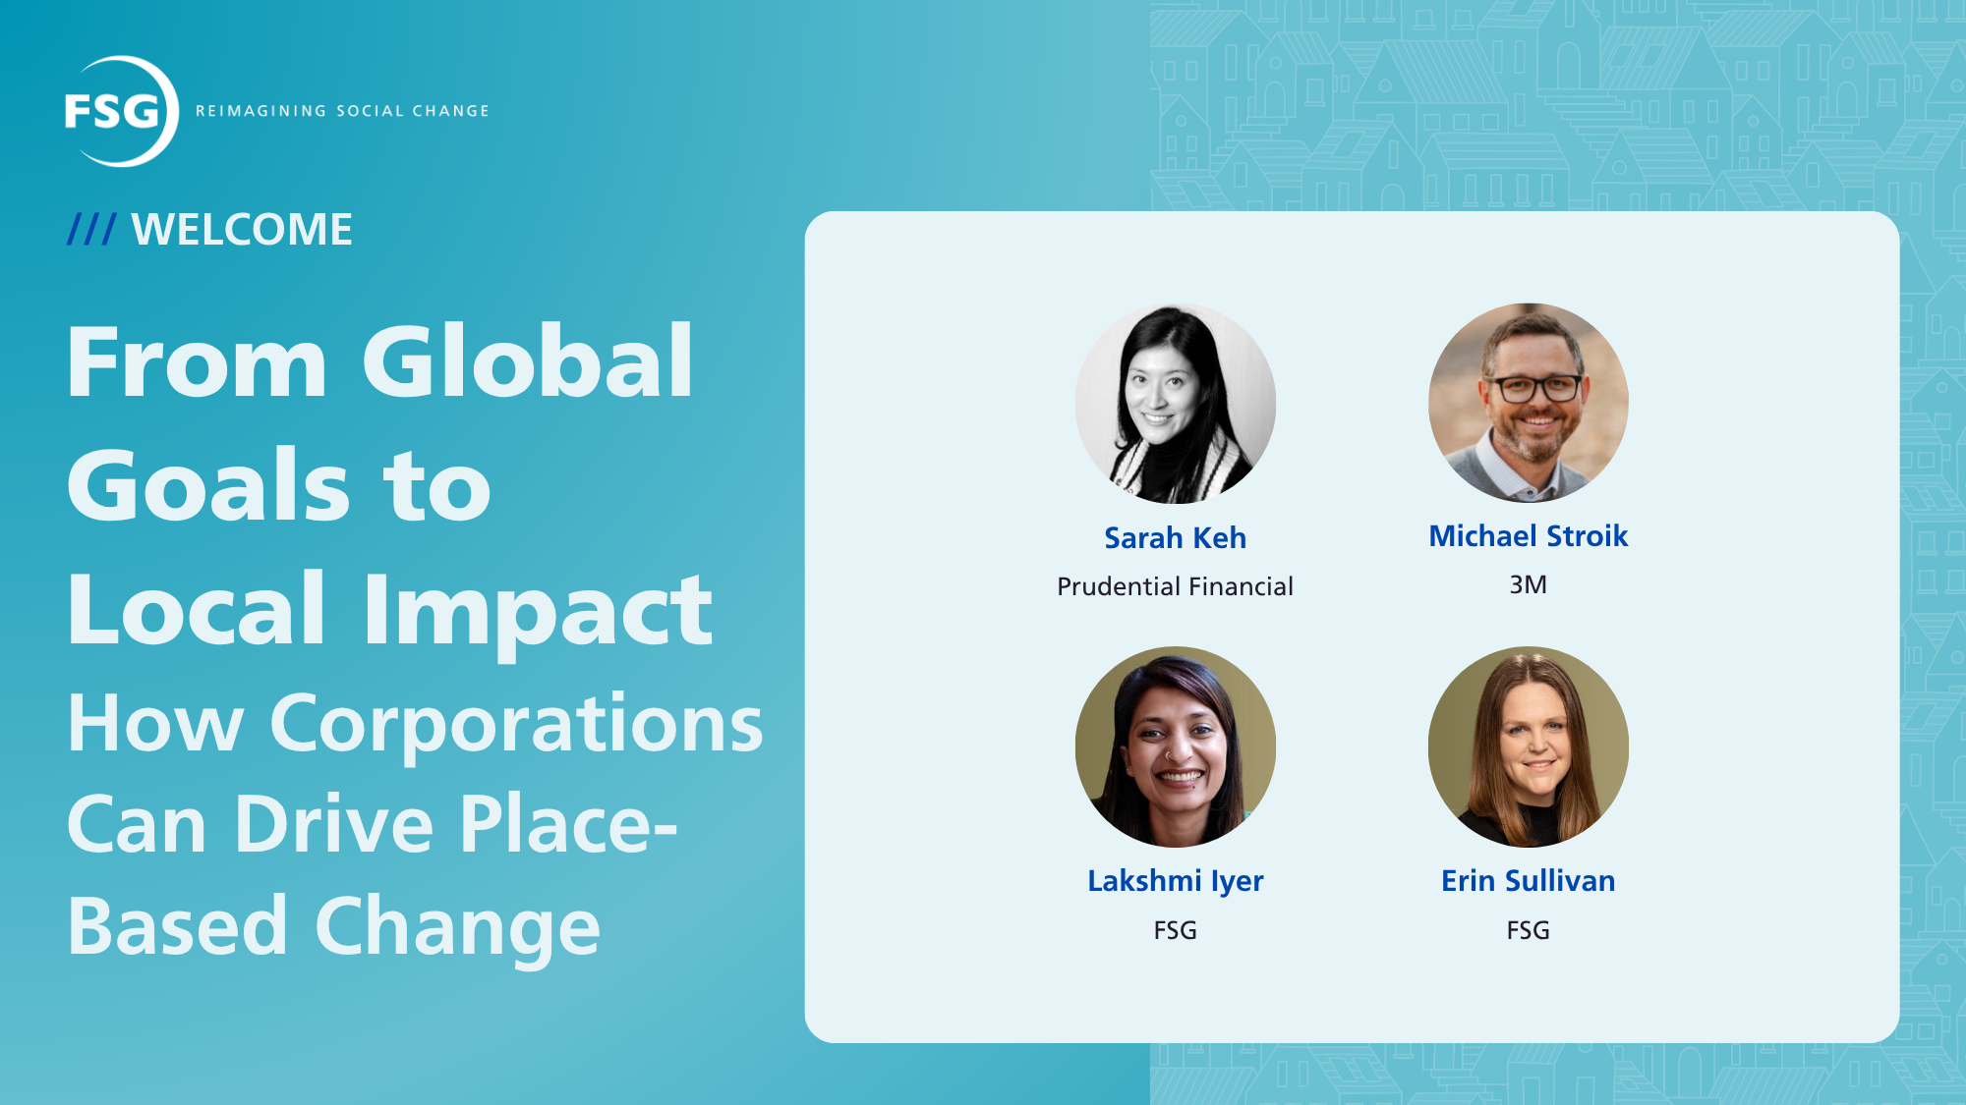

Slide 2
Tech Tips
We want to hear from you!
Share your questions in the Q&A Box. We will be reserving time at the end for Q&A.
Tech Tips
The recording and slides will be made available on FSG.org. We’ll send you an email once they’re online.
If you wish to turn on live captions, go to your webinar menu and choose “Show Captions.”
If you have technical difficulties or need help with anything, please email info@fsg.org

Slide 3
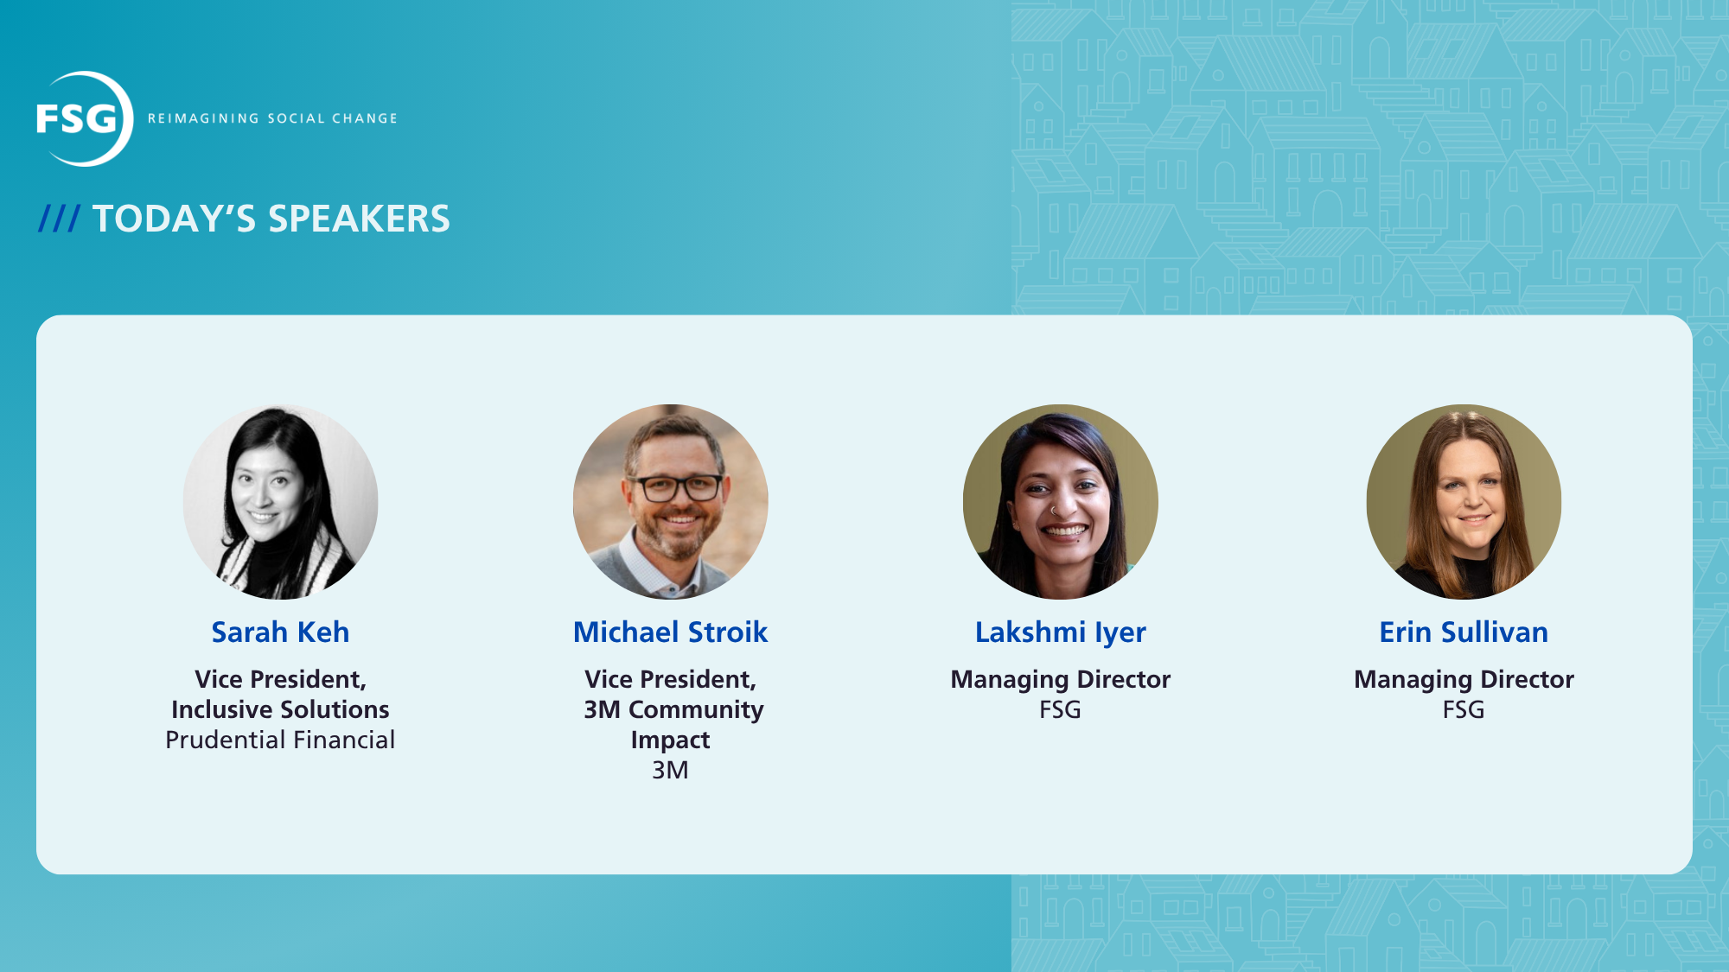

Slide 4
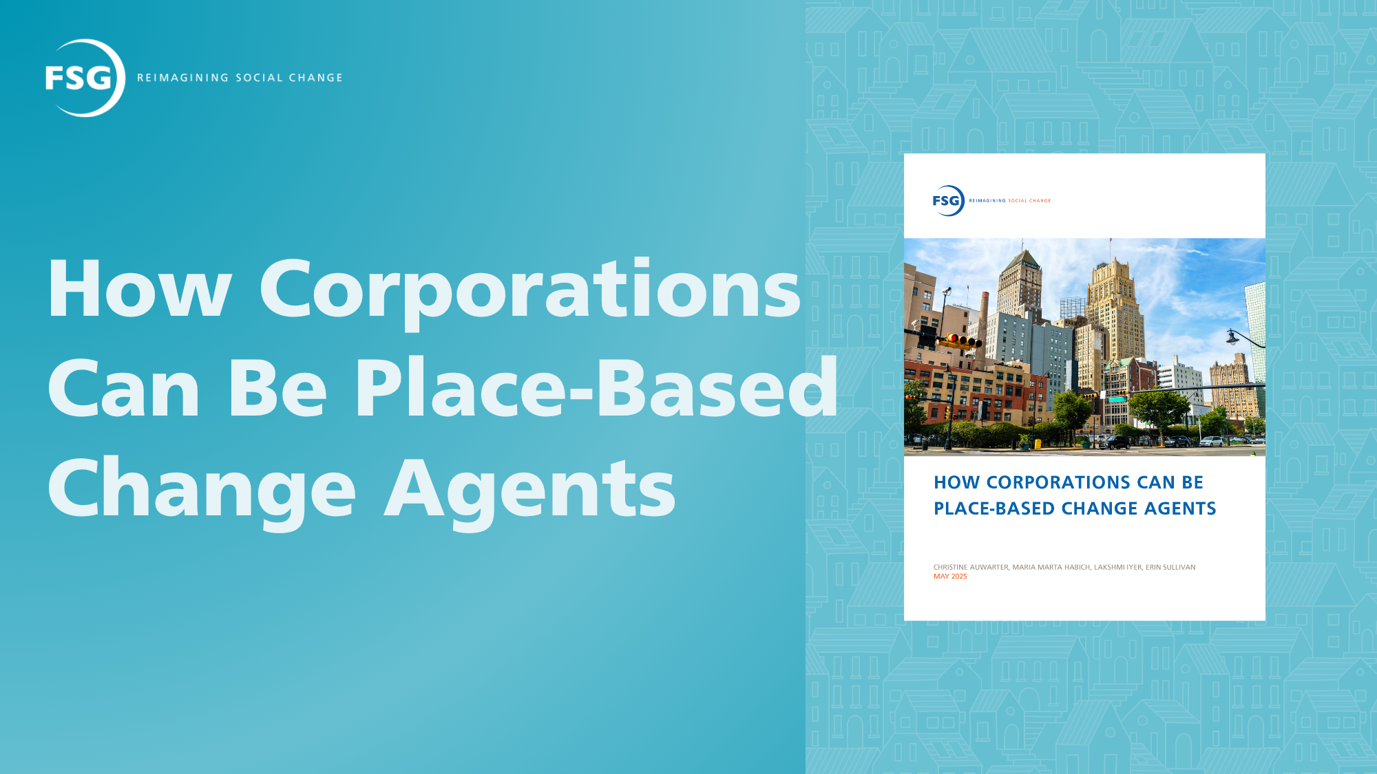

Slide 5
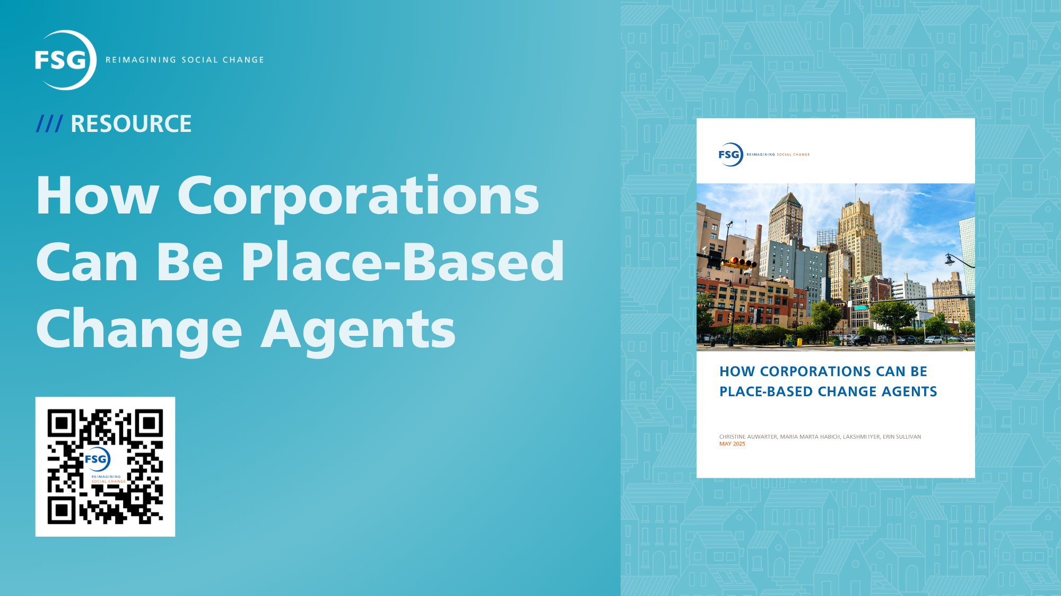

Slide 6




Four Archetypes of Corporate Place-based Change Agents
THE ANCHOR INSTITUTION
Companies that catalyze local economic growth by buying, hiring, investing, and giving locally
THE COLLABORATOR
Companies that catalyze or support multisector place-based collaborations to solve a shared challenge
THE SPECIALIST
Companies who prioritize one specific locally relevant social issue and use a range of resources to address it
THE COMMUNITY-DIRECTED DONOR
Companies who design their local investment strategies by prioritizing community voice and input

Slide 7
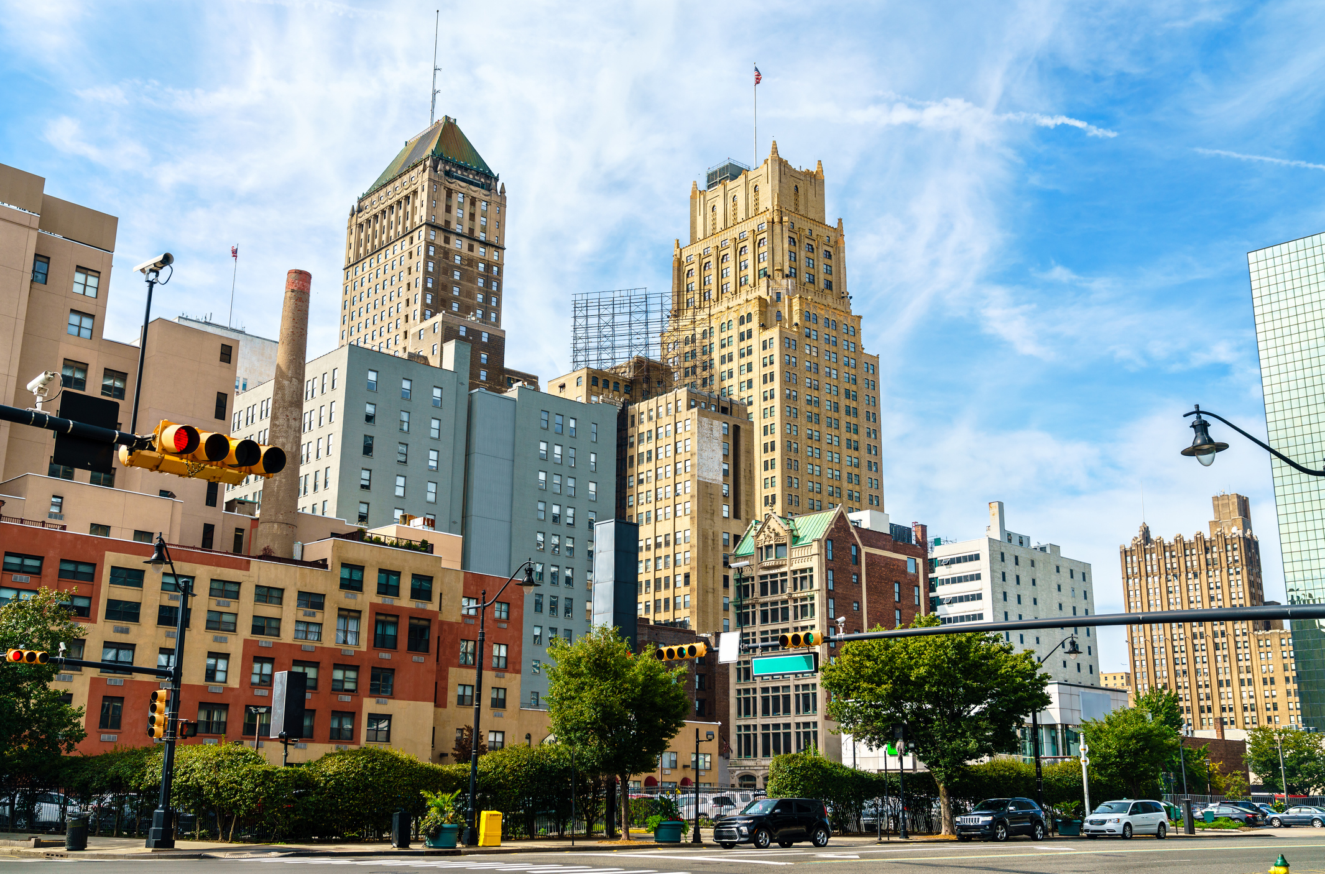
Zoom Audience Poll
How would you describe your organization’s primary role in place-based change today?
Choose 1 of the 4 archetypes

Slide 8
Guiding Principles
Understand your company’s why before you design the role
Regardless of your role, learn from and co-develop solutions with the community
Go beyond grantmaking: Use all your business assets to drive impact
Take the opportunity for enterprise-wide leadership

